Slide 1





Covid-19
Covid-19 Positive Infections: A Correlation study of Age Group Distribution

Slide 2

Objective
This project aims at establishing correlation of age group distribution of COVID-19 infected patients.

Slide 3
Introduction
COVID-19 also known as Coronavirus has been the top health issue that the whole world faces for the past 12 months. This disease strikes at such an inscrutable tone that prompts health experts to race for a vaccine to put it to an end. This highly contagious disease has infected millions of people around the world, and it has taken the lives of thousands in a short interval of time. Its devastating effects across the globe have made it a very significant pandemic that raised a lot of concerns as to how to contain its spread.

Slide 4
Treatment
Hydroxychloroquine but rejected by the FDA due to due to risk of heart rhythm problems.
Remdesivir/Veklury, October 2020 FDA approved as possible treatment for Covid-19
SARS-CoV-2
Be.
Benefits limited in patients who needed mechanical ventilation.
mRNA vaccine early December Pfizer/Moderna FDA approved.

Slide 5

Transmission Methods
Transmission mode is not very well understood since the virus understood, and the virus is under strict surveillance control.
Person to person via droplets or tiny particles called aerosols from coughs, sneezes, or talks of infected persons.

Slide 6
Method
The dataset used from this project was obtained from data.gov. It is a collection of positive COVID-19 test results that have been reported each day by the local health department via the ESSENCE system. The collection provides positive COVID-19 cases among Maryland residents by age: 0-9; 10-19; 20-29; 30-39; 40-49; 50-59; 60-69; 70-79; 80+; Unknown.
https://catalog.data.gov/dataset/md-covid-19-cases-by-age-distribution

Slide 7
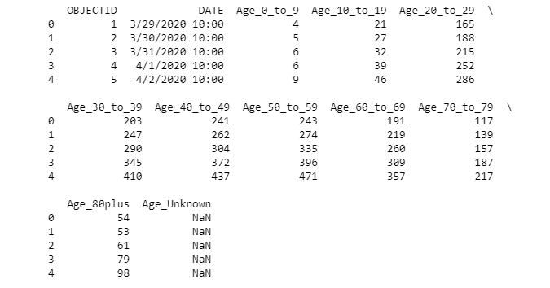
The Data +Target Variables

Slide 8
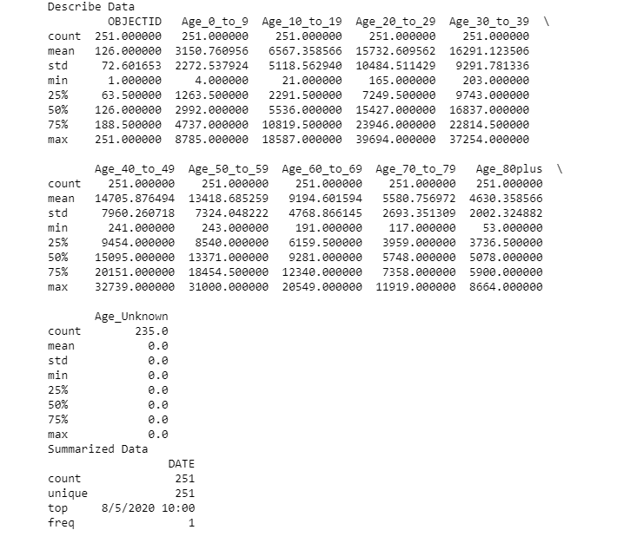
Data + Variables
Age_40_to_49
Target variables
Age_20_to_29
Age_40_to_49
Age_60_to_69
Age_80plus

Slide 9
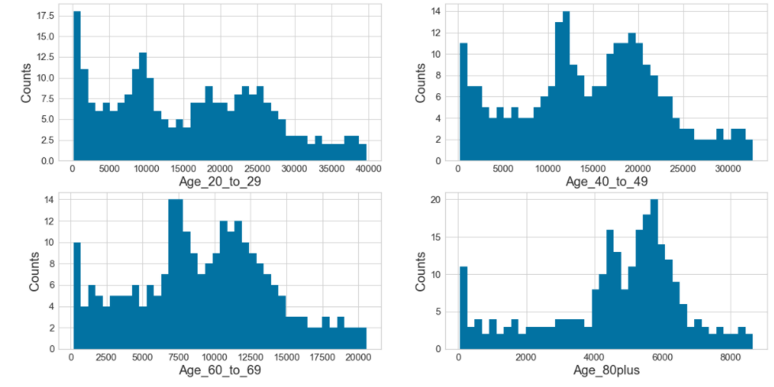
Results

Slide 10
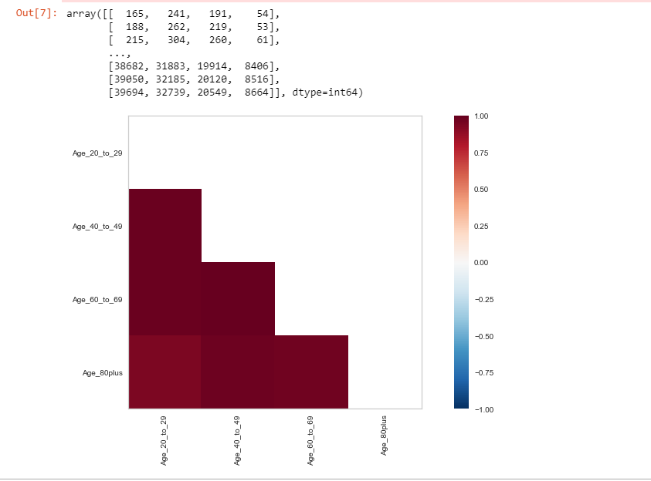
Pearson Rank
Correlation Test
Age_20_to_29
Age_40_to_49
Correlation coefficient = 0.991
Age_80plus
Age_20_to_29
Correlation coefficient = 0.941
Age_80plus
Correlation coefficient = 0.941
Age_20_to_29
Correlation coefficient = 1.000

Slide 11
Code
Github
https://github.com/cherf001/cherf001.github.io

Slide 12
References
1-Jung Ki Kim, Eileen M. Crimmins: How does age affect personal and social reactions to COVID-19: Results from the national Understanding America Study, November 10, 2020
https://journals.plos.org/plosone/article?id=10.1371/journal.pone.0241950#:~:text=About%2079%25%20of%20COVID%2D19,55%E2%80%9364%2C%200.02%25%20for
2-Matthew Herper: Covid-19 study details benefits of treatment with remdesivir, and also its limitations, May 22, 2020
https://www.statnews.com/2020/05/22/covid-19-study-details-benefits-of-treatment-with-remdesivir-and-also-its-limitations/
3-Mahase E. COVID-19: death rate is 0.66% and increases with age, study estimates. BMJ. 2020
4-Richard T. Eastman, Jacob S. Roth, Kyle R. Brimacombe, Anton Simeonov, Min Shen, Samarjit Patnaik, and Matthew D. Hall - Remdesivir: A Review of Its Discovery and Development Leading to Emergency Use Authorization for Treatment of COVID-19 - ACS Cent Sci., May 27, 2020
https://www.ncbi.nlm.nih.gov/pmc/articles/PMC7202249/
5-FDA News Release: FDA Approves First Treatment for COVID-19, October 22, 2020
https://www.fda.gov/news-events/press-announcements/fda-approves-first-treatment-covid-19
6-US Food and Drug Administration: FDA’s approval of Veklury (remdesivir) for the treatment of COVID-19—The Science of Safety and Effectiveness, October 22, 2020
https://www.fda.gov/drugs/drug-safety-and-availability/fdas-approval-veklury-remdesivir-treatment-covid-19-science-safety-and-effectiveness
7-Wang C., Liu Z., Chen Z., Huang X., Xu M., He T. The establishment of reference sequence for SARS-CoV-2 and variation analysis. J Med Virol. 2020 [PMC free article] [PubMed]
8-https://coronavirus.app/map?mode=infected
9- https://www.who.int/emergencies/diseases/novel-coronavirus-2019

